Slide 1
New Products Introduction
A Brand New Co-Polymer
& New Polycarbonate Alloys
- One Fits MOST
For Polycarbonate
Structures Physical / Chemical
Ricky C.J. Chang KUNI Applied Materials Co., Ltd.

Slide 2
Table of Content
A Brand New Co-polymer for Polycarbonate
-Regular Polycarbonate Structure
-The Structure of This New Co-polymer
-The Properties of This New Co-polymer
Co-polymer Alloying with Other Miscible polymer
-PC/ASA One Grade fits MOST

Slide 3
O₂
Regular Polycarbonate
O
CH₃
C
C
O
C
O
CH₃
n
Highly Polar in chemical structure → Can be easily degraded by H2O → Silver → Brittle
Weak Chemical Bonding → Naturally Brittle
Complicated Branching → Mold Flow Difficulty
Amorphous Polymer → Vulnerable from Chemical Attack

Slide 4
Story starts from here…
The silicone brings
low temp impact
weatherability
release
The PC brings
heat
modulus
No liquid additives
Low plate out
No juicing
O
CH₃
C
C
O
No free silicone
C
O
CH₃
n
It is called “ Poly DiMethyl Siloxane “ Polycarbonate
- A Brand New Co-Polymerized Polycarbonate

Slide 5
Let Us Check it Out from Public Information…
https://en.wikipedia.org/wiki/Polydimethylsiloxane
“ Polydimethylsiloxane (PDMS) belongs to a group of polymeric organosilicon compounds that are commonly referred to as silicones.^{[1]} PDMS is the most widely used silicon-based organic polymer, and is particularly known for its unusual rheological (or flow) properties. PDMS is optically clear, and, in general, inert, non-toxic, and non-flammable. It is also called dimethicone and is one of several types of silicone oil (polymerized siloxane). Its applications range from contact lenses and medical devices to elastomers; it is also present in shampoos (as dimethicone makes hair shiny and slippery), food (antifoaming agent), caulking, lubricants, kinetic sand, and heat-resistant tiles. “
And, lots of technical information can be found about it…..

Slide 6
KEY Attributes…
Low Temp. Ductility
High Productivity from its
flow
Polydimethylsiloxane
Polycarbonate
Weathering
Chemical Resistance
Release Performance

Slide 7
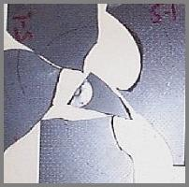
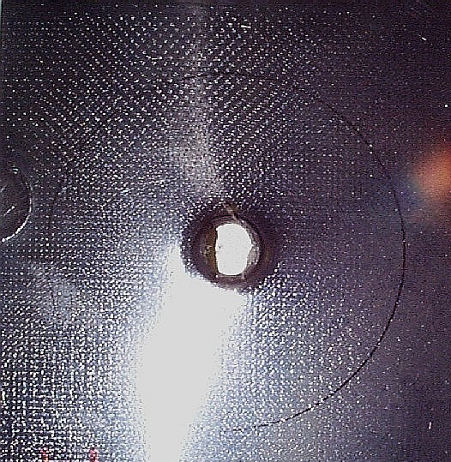
How Can It Help You ?
Highly Ductile Impact Modified Polydimethylsiloxane PC
Upgrade from standard ETP’s (ductile to –40 °C)
Robust PC material with NO FRAGMENTATION

Slide 8
A PC with Outstanding Processability and higher flow in mold
Shorter cycle time larger process window
Upgrade from PC without sacrificing ductility
Regular PC (MFR=12)
60 Mil Thickness
PDMS PC (MFR=12)
Regular PC (MFR=12)
PDMS PC (MFR=12)
30 Mil Thickness

Slide 9
A Chemically Resistant PC
Increased from standard PC products
Chemical Resistance（PDMS PC）
Chemicals Retention %
Formula409 102
Windex 92
Grease 111
WD-40 92
Suntan Lotion 98
10％ 硝酸 99
１％ 硫酸 98
* Immersion at Room Temp for 24Hrs with Sample specimen

Slide 10
PDMS PC for Heat Aging
Still Ductile after 1000h @ 110
°C

Slide 11
Now, let us see how can it perform?
KUNI Applied Materials KELITE 911 Resin
Grade: 911M10
Code: NC/GPBK/RBBK/MTBK/WT
Characteristics: Low Temperature Impact with 80% properties retention at -40°C. Excellent weatherabillity.
Typical Property | Test Method | Test Condition | Unit | Value
Physical
Density | ISO 1183 | - | g/cm³ | 1.18
Water Absorption | ISO 62 | 24h 50%RH | % | 0.2
Mechanical
Tensile Strength | ASTM D638 | 23℃,50 mm/min | kg/cm² | 530
Tensile Strain | ASTM D638 | 23℃,50 mm/min | % | 80
Flexural Strength | ASTM D790 | 23℃,2 mm/min | kg/cm² | 950
Flexural Modulus | ASTM D790 | 23℃,2 mm/min | kg/cm² | 24,500
Tensile Strength | ISO 527 | 23℃,50 mm/min | MPa | 52
Flexural Strength | ISO 527 | 23℃,2 mm/min | MPa | 93
Flexural Modulus | ISO 527 | 23℃,2 mm/min | MPa | 2,400
Rockwell Hardness | ASTM D785 | 23℃ | - | 119
Izod Impact Strength | ASTM D256 | notched, 23℃ | kg-cm/cm | 75
Izod Impact Strength | ASTM D256 | notched, -30℃ | kg-cm/cm | 60
Izod Impact Strength | ASTM D256 | notched, -40℃ | kg-cm/cm | 55
Charpy Impact Strength | ISO 179 | notched, 23℃ | KJ/cm² | 70
Charpy Impact Strength | ISO 179 | notched, -30℃ | KJ/cm³ | 55
Charpy Impact Strength | ISO 179 | notched, -40℃ | KJ/cm² | 50
Optical
Light Transmittance(NC) | ASTM D-1003 | 3.2mm | % | <70
Haze(NC) | ASTM D-1003 | 3.2mm | % | >15
Thermal
Melt Flow Index | ASTM D-1238 | 300℃@1.2kg | g/10min | 12
Heat Deflection Temp. | ASTM D648 | 1.8Mpa | ℃ | 122
 |  | 0.45Mpa | ℃ | 135
Mold shrinkage | 3.0mm MD | Die Temp. 80℃ | % | 0.6~0.8
 | 3.0mm TD | Die Temp. 80℃ | % | 0.6~0.8
Flammability
Flammability Rating | UL94 | UL HB | mm | 1.5
UL light, water exposure and immersion | UL 746C | - | - | -
Relative Temp Index | UL 746B | Elec | ℃ | 60
 | UL 746B | Mech w/impact | ℃ | 60
 | UL 746B | Mech w/o impact | ℃ | 60
All tests were run under laboratory conditions, ASTM, ISO testing procedures. The data are intended as a general guide only.
Potential Advantages
Impact: Best ductility to -40 degree C.
Chemical Resistance: Improved when compared to standard PC.
Weatherability: Excellent retention of mechanical properties in outdoor.
Aging: Better retention of properties vs PC.
Knitline Strength: Significant improvement over PC and most materials.
Processing: Longer flow length and lower injection pressure than PC resins.
Easy release: Allows for shorter molding cycle times and lower draft angles.

Slide 12
When Alloy with ASA…
KUNI Applied Materials KELITE 911 Resin
Grade: AC807K
Code: -
Characteristics: Excellent weatherabillity.
Typical Property | Test Method | Test Condition | Unit | Value
Physical
Density | ISO 1183 | - | g/cm³ | 1.15
Water Absorption | ISO 62 | 24h 50%RH | % | 0.2
Mechanical
Tensile Strength | ASTM D638 | 23℃,50 mm/min | kg/cm² | 600
Tensile Strain | ASTM D638 | 23℃,50 mm/min | % | 90
Flexural Strength | ASTM D790 | 23℃,2 mm/min | kg/cm² | 1,000
Flexural Modulus | ASTM D790 | 23℃,2 mm/min | kg/cm² | 23,000
Tensile Strength | ISO 527 | 23℃,50 mm/min | MPa | 59
Tensile Strain | ISO 527 | 23℃,50 mm/min | % | 90
Flexural Strength | ISO 527 | 23℃,2 mm/min | MPa | 98
Flexural Modulus | ISO 527 | 23℃,2 mm/min | MPa | 2,300
Rockwell Hardness | ASTM D785 | 23℃ | - | 117
Izod Impact Strength | ASTM D256 | notched, 23℃ | kg-cm/cm | 60
Charpy Impact Strength | ISO 179 | notched, 23℃ | KJ/cm² | 55
Izod Impact Strength | ASTM D256 | notched, -30℃ | kg-cm/cm | 36
Charpy Impact Strength | ISO 179 | notched, -30℃ | KJ/cm² | 33
Optical
Gardner Gloss(60º,Untextured) | ASTM D523 | 23℃ | - | 100
Thermal
Melt Flow Index | ASTM D-1238 | 240℃X5kg | g/10min | 9
 |  | 260℃X5kg | g/10min | 23
Melt Volume Rate | ISO 1133 | 240℃X5kg | cm³/10min | 7.8
 |  | 260℃X5kg | cm³/10min | 20
Vicat Softening Temp | ISO 306 | Rate B/50 | ℃ | 130
 |  | Rate B/120 | ℃ | 132
Heat Deflection Temp. | ASTM D648 | 1.8Mpa | ℃ | 110
 |  | 0.45Mpa | ℃ | 130
 | ISO 75 | 1.8Mpa,80*10*4 | ℃sp=64mm | 108
 |  | 0.45Mpa,80*10*4 | ℃sp=64mm | 128
Mold shrinkage | 3.0mm MD | Die Temp. 80℃ | % | 0.5~0.7
 | 3.0mm TD | Die Temp. 80℃ | % | 0.5~0.7
Flammability
Flammability Rating | UL94 | UL HB | mm | 1.5
UL light, water exposure and immersion | UL 746C | - | - | -
Relative Temp Index | UL 746B | Elec | ℃ | 60
 | UL 746B | Mech w/impact | ℃ | 60
 | UL 746B | Mech w/o impact | ℃ | 60
Alloying with ASA for much better weatherability and color retention.
Possibility for Mold-in-Color.
Low temperature impact with property retention 65% at -30°C.
Very high flow at 26 g/10 min at 260°C.
Knitline strength.
Excellent processing window.
Heat aging strength.
Hydrolysis stability.
Easy release in tooling.
Potential application: Interior mold-in-color cover trim, Interior/Exterior MIC Door handle, exterior front grille, roof rack, spoiler, Bumper beam module

Slide 13
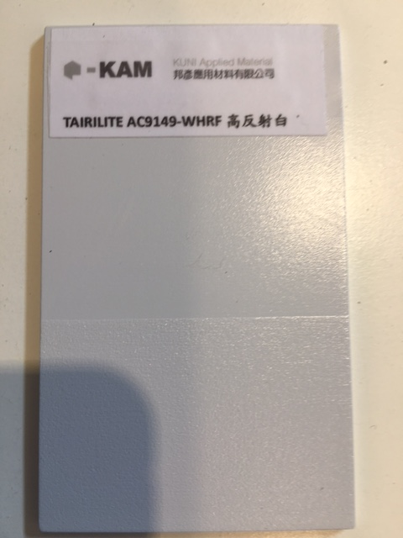
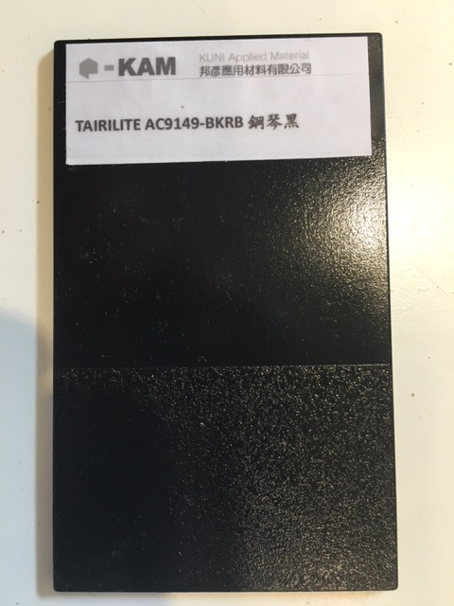
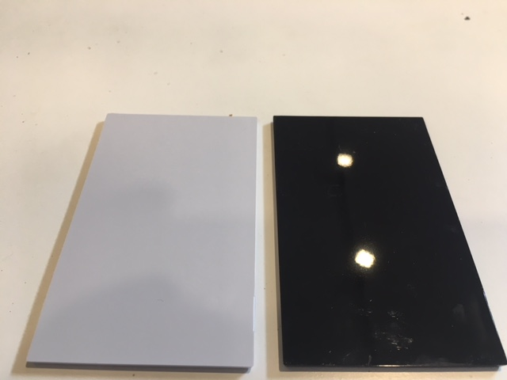
Special Effect Colors Available…
Highly Impact, Low Temp Impact(-40C)
Weatherability for Color Retention
Highly Reflective above 95% of light
Reduce Secondary Operation to Save Cost
高反射白
低溫高耐衝, 韌度高 (-40C)
高耐候保持彩度最持久
100%遮光, 95%光線反射度
減少二度加工(噴漆, 鋁蒸著)省成本
高反射白

Slide 14
Thank you for your attention and your precious time!
Any Question?
Thank you !!

